Slide 1
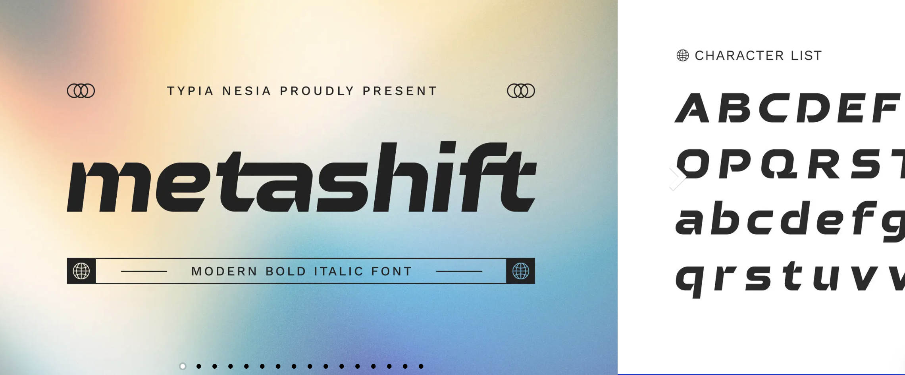
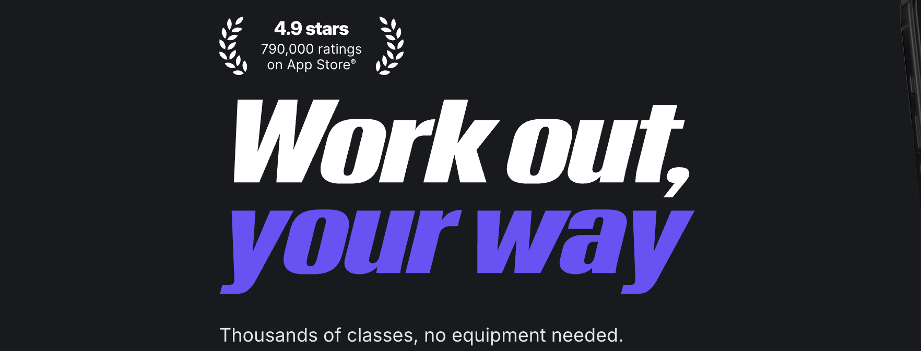
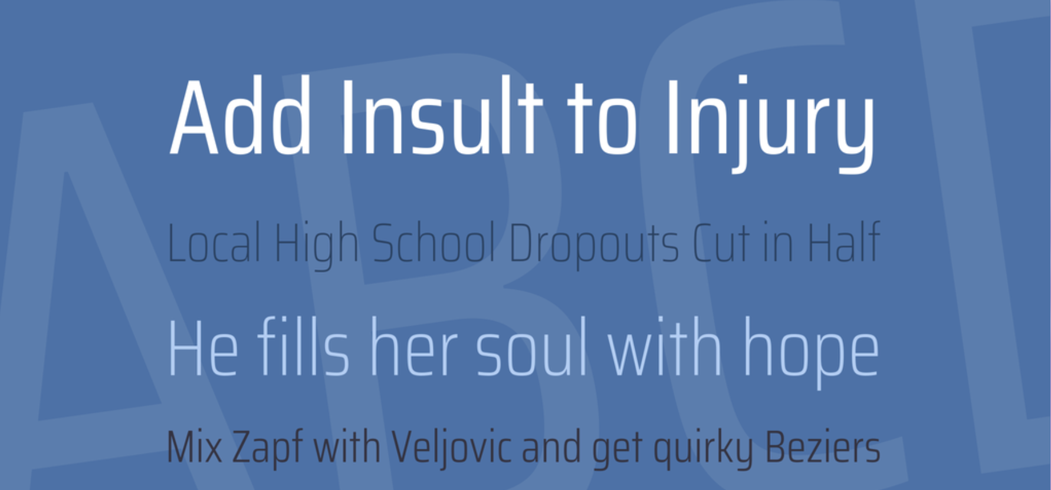
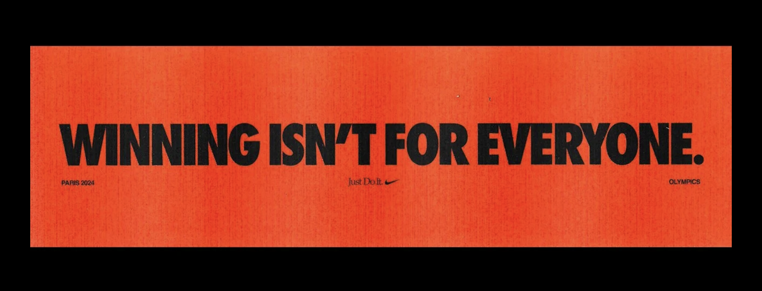
Typography
Notes
Italic slant to give forward motion
Bold to convey strength & drive
Condensed to maximize screen space

Slide 2
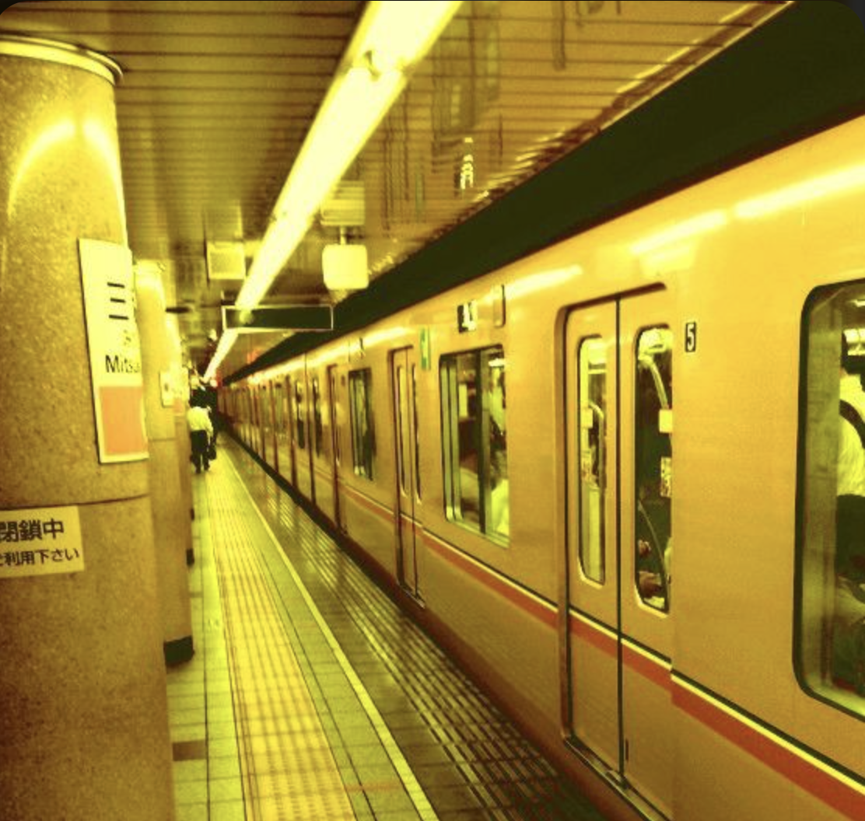
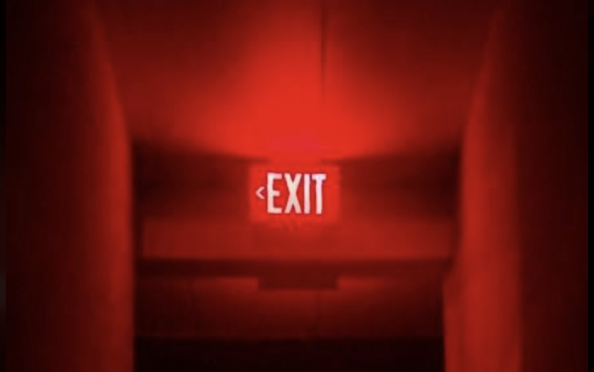


#fcd126
#00d772
#f30300
Colors
rgba(252, 209, 38, 0.12)
rgba(0, 215, 114, 0.12)
rgba(243, 3, 0, 0.12)
Notes
Function | Solid (Text/Icon) | Transparent(bg/boarder) | Usage
Primary / Brand (Energy) | #FCD126 | rgba(252, 209, 38, 0.12) | Titles, accent icons, main buttons (Start Workout, Ask AI, Add Workout)
Success / Positive Action | #00D772 | rgba(0, 215, 114, 0.12) | Finish Workout, Save, Completed Set
Error / Negative Action | #F30300 | rgba(243, 3, 0, 0.12) | Cancel Workout, Delete, Reset
Supporting / Depth tones | #6E5A17, #1E5530, #641714 | Used subtly as backgrounds, shadows, or borders to match the above tones
Neutral / Text | #FFFFFF |  | Normal text, info labels
Background Base | #0D0D0D |  | Dark mode base so colors glow cleanly

